Slide 1
CSC207 Final Project Presentation
Presented by Group #24
Alice Baker
Yue chen
Yuewen zhang
Zhikang Tian

Slide 2
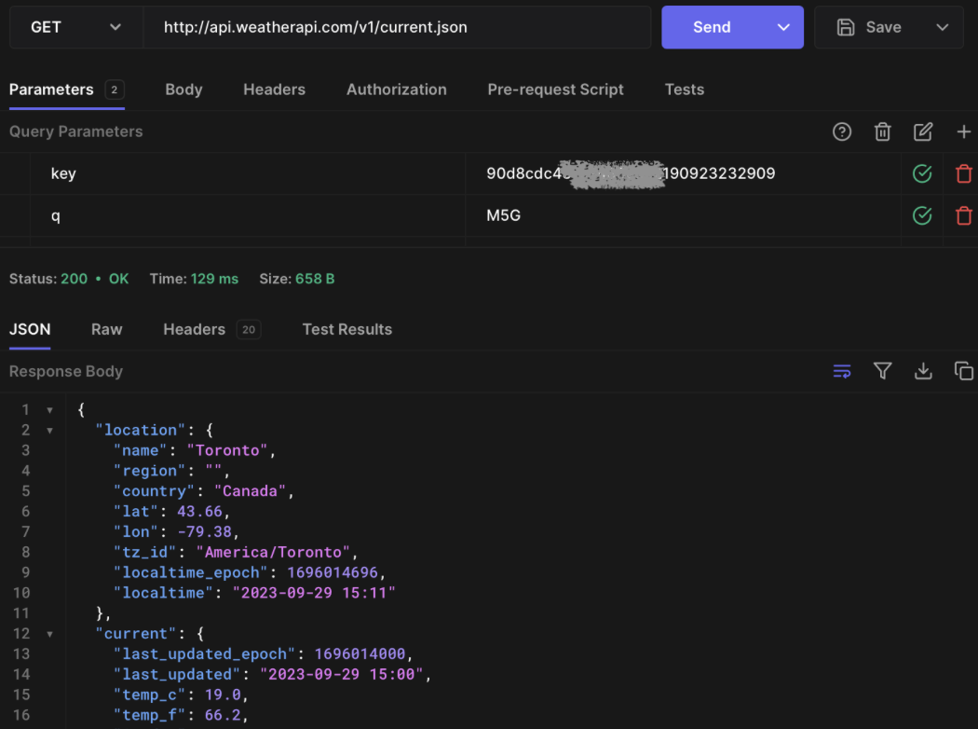

Weather api
Our Project has connected Weather API from weatherapi.com, which is an API can help us get detailed weather conditions based on the location we provide.
We have chose this API as it is free for us to get information and easy to connect and parse.
An example screenshot from hoppscotch.io of GET from Weather API for location of Toronto.

Slide 3
API Endpoint

Slide 4






Specification
New User Sign Up: username and location
User Login
Get Weather: Get weather conditions from the API
Portal to Group: GroupView, access to group features
(Not Ready) Portal to Trip
Group
Create Group
Edit Group
Trip
Create Trip
Edit Trip

Slide 5
demo

Slide 6
Software design

Slide 7

SOLID principles
While we design our program and codes, we followed the principles what we have learnt in this course, by adherence to SOLID principles, our codes are promoted to be more understandable, flexible, and maintainable software design.
Here are the three SOLID Principles we will evaluate further:
Single Responsibility Principle (SRP)
Interface Segregation Principle (ISP)
Dependency Inversion Principle (DIP)

Slide 8
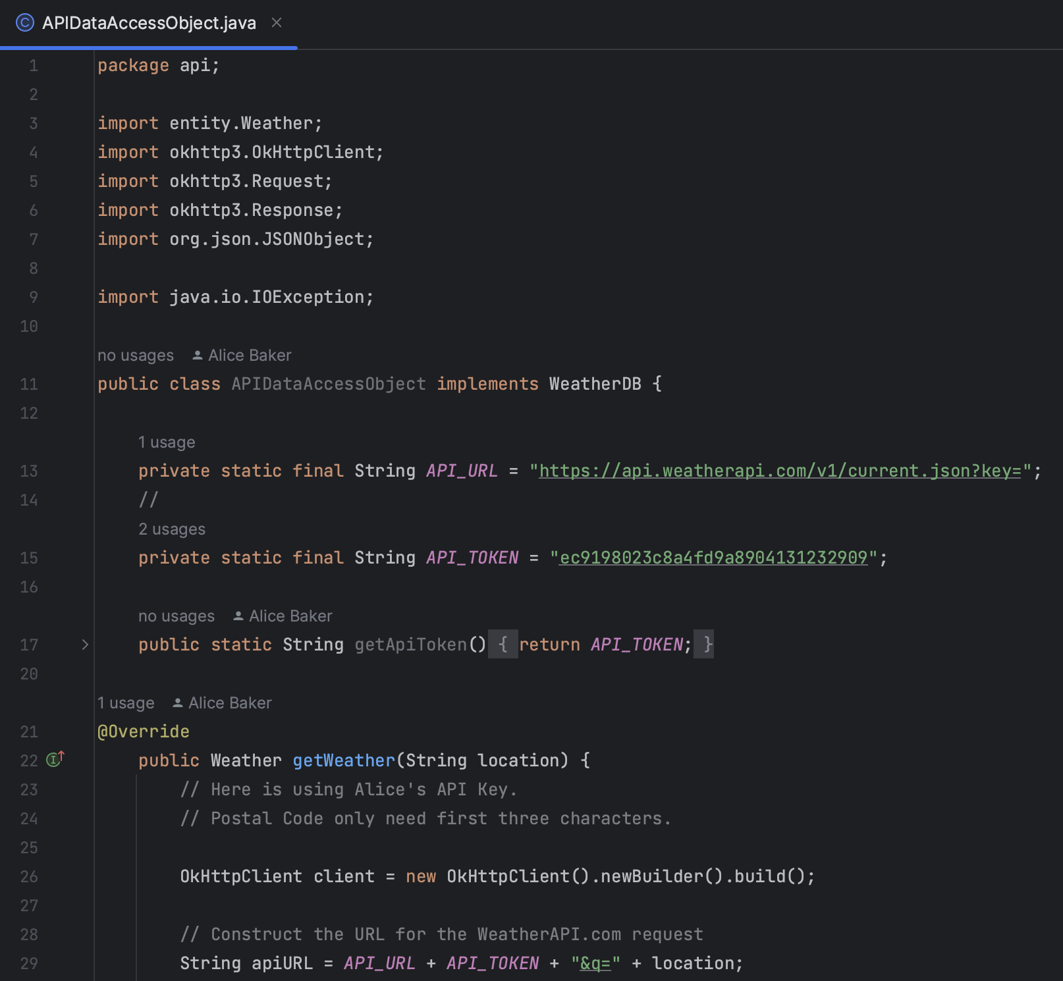
Single Responsibility Principle (SRP)
In our code, one class has only one responsibility, for example, the APIDataAccessObject class that only handles fetching weather data (GET) from the API, while View and other elements are from other classes.
Same as other use cases, each class in the code only process their own responsibility.

Slide 9
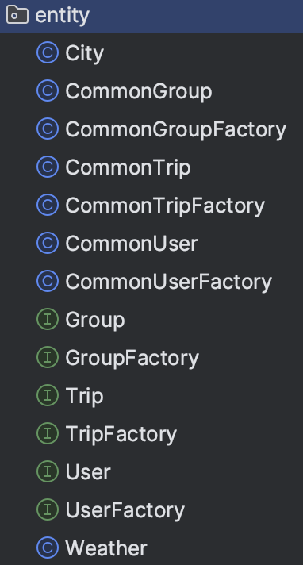
Interface Segregation Principle (ISP)
Specific Interfaces for Different Features: Our application uses different interfaces for distinct functionalities. For example, we have separate interfaces for user management (User), weather data handling (Weather), and group management (Group).
Segregating these interfaces makes the code more modular and easier to update, changes in the group management feature (add a feature called leave group) won't affect the user management part (no need to modify User interface), as they rely on different interfaces.

Slide 10
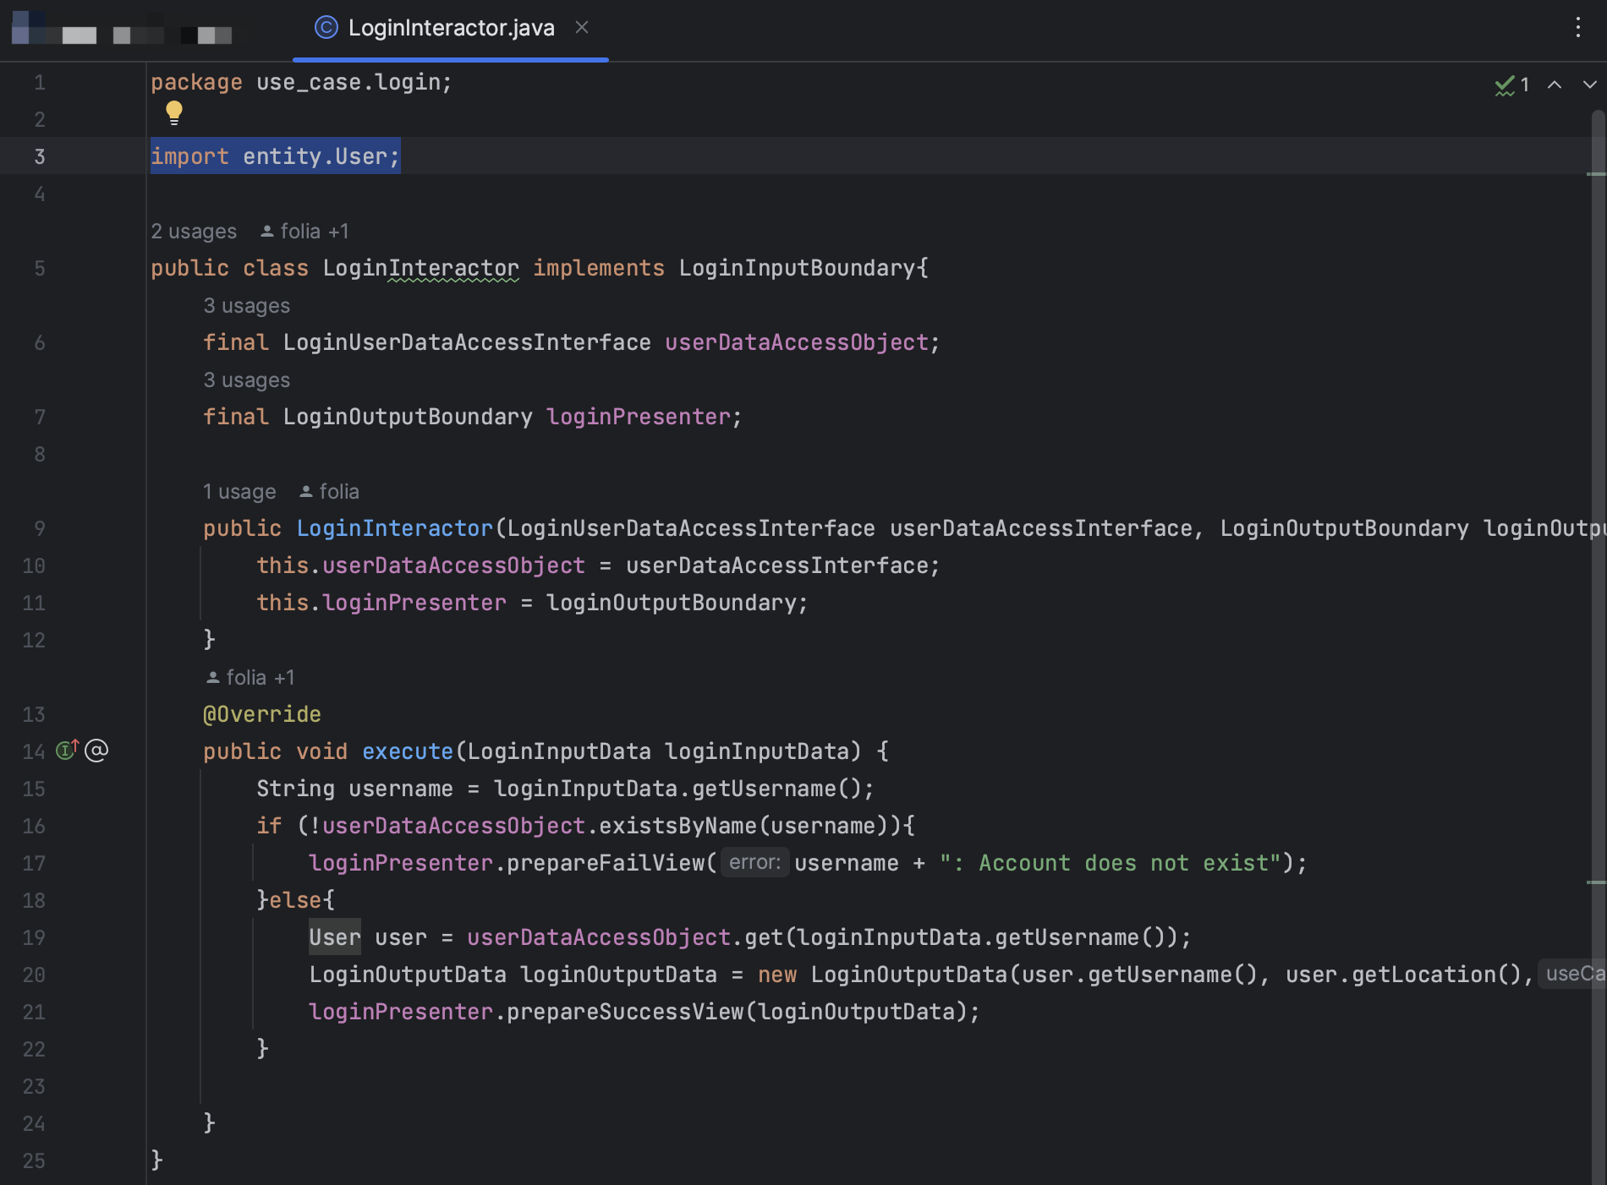
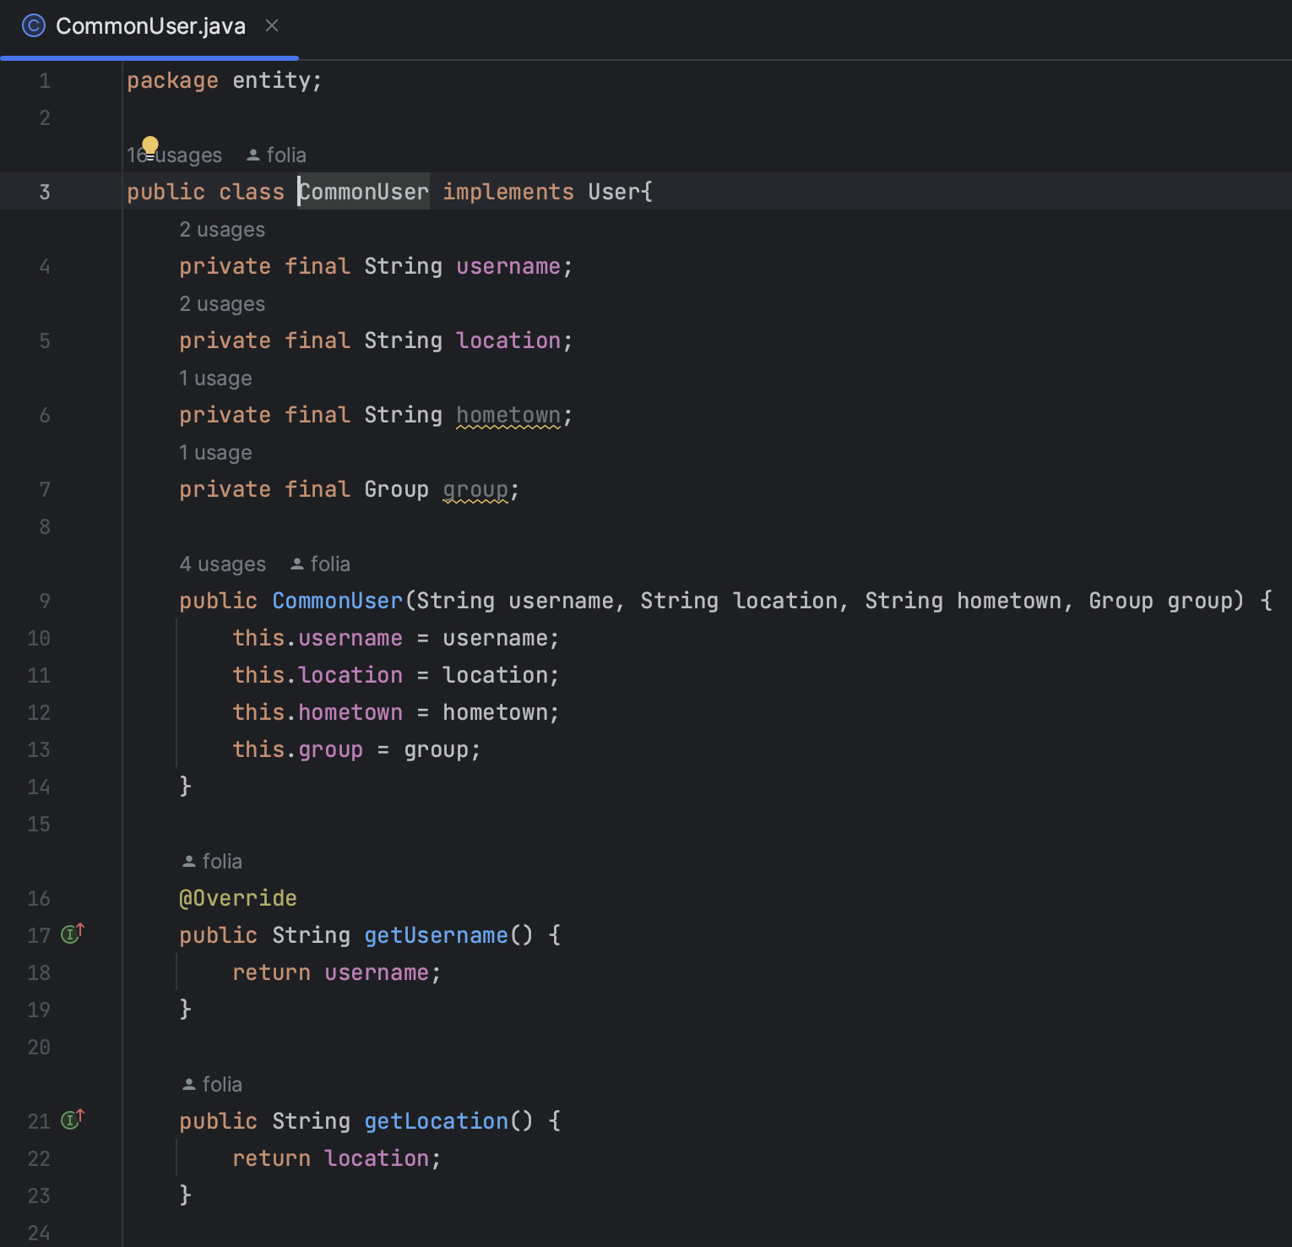
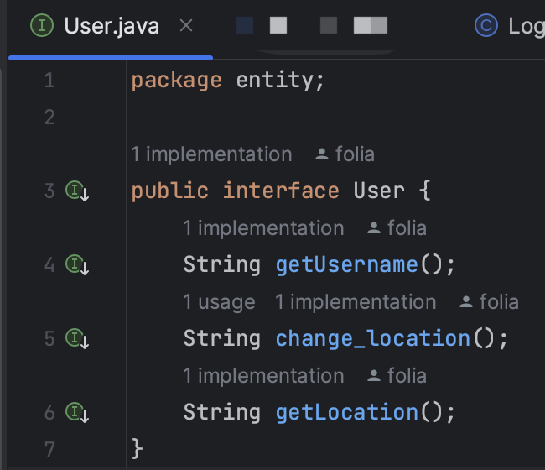
Dependency Inversion Principle (DIP)
Our code is just like the principle says, high-level modules like user interaction handlers depend on abstract interfaces rather than concrete implementations. For example, our LoginInteractor depends on User interface rather than the concrete CommonUser class.
This demonstrates a clear adherence to DIP and makes our application more flexible and testable.

Slide 11

Clean architecture
Clean Architecture is the base of our Project. This is to say, all of our codes are built upon Clean Architecture – strictly following the rules and the Clean Architecture Engine, which ensured that our project codes are easy to maintain, extend, and test, largely due to its emphasis on separation of concerns and the Dependency Rule.

Slide 12
Design patterns

Slide 13
Testing

